Slide 1
2.3 HCI in sw process

Slide 2
HCI in Software Processes
Star Life-cycle Model
Usability Life-cycle Model
Notes:
1

Slide 3
Lifecycle Models
Show how activities are related to each other
Lifecycle models are:
management tools
simplified versions of reality
Many lifecycle models exist, for example:
from software engineering: waterfall, spiral, JAD/RAD, Microsoft
from HCI: Star, usability engineering

Slide 4
Definition of Software Engineering
Fairley’s:
Software engineering is the technological and managerial discipline concerned with systematic production and maintenance of software products that are developed and modified on time and within cost estimates.
Engineering versus science:
Production, practical, quality, maintenance, reuse, standards, teams, management, etc.

Slide 5
What’s the Problem?
Software costs are increasing as hardware costs decline.
Many software development disasters:
Cost overruns, late delivery
Reduced or wrong functionality, non-existent documentation
Many failures attributed to software
Cost of failure becoming very high:
Financial
Loss of life or loss of equipment
Inconvenience

Slide 6
Various Models for SW Lifecyles
“Historical Models”
Waterfall model
Spiral model
Corporate “Standards” or common practices
Many companies define their own.
Perhaps using:
Unified Process (was the Rational U.P.)
Extreme Programming

Slide 7
Why Learn About Process Now?
There are general principles of about:
What do we do at various stages of SW development
How to inject quality into SW
How to avoid early problems that cause huge problems later
Recognize that SE is not just writing code

Slide 8
HCI in the Software Process
Software engineering and the design process for interactive systems
Usability engineering
Iterative design and prototyping
Design rationale

Slide 9
HCI is used in software process to interact product with users and give them a simple and comfortable interface.
Software developers check the environment that it is simple and interactive for selected environment and it is only possible human interaction.
In addition, cultural and national differences play a part.
Another consideration in studying or designing HCI is that user interface technology changes rapidly, offering new interaction possibilities to which previous research findings may not apply.
Finally, user preferences change as they gradually master new interfaces.

Slide 10
The Software Lifecycle
Software engineering is the discipline for understanding the software design process, or life cycle
Designing for usability occurs at all stages of the life cycle, not as a single isolated activity

Slide 11
The Life Cycle for Interactive Systems
lots of feedback!
cannot assume a linear sequence of activities as in the waterfall model
Requirements specification
Architectural design
Detailed design
Coding and unit testing
Integration and testing
Operation and maintenance

Slide 12
A Simple Interaction Design Model
Identify needs/
establish
requirements
(Re)Design
Evaluate
Build an
interactive
version
Final product
Exemplifies a user-centered design approach

Slide 13
The Star Lifecycle Model
Suggested by Hartson and Hix (1989)
Important features:
Evaluation at the centre of activities
No particular ordering of activities. Development may start in any one
Derived from empirical studies of interface designers

Slide 14
The Star Model (Hartson and Hix, 1989)
Implementation
task/functional
analysis
Prototyping
Evaluation
Requirements
specification
Conceptual/
formal design
Notes:
Primary activity that unites all phases is usability evaluation
How will we proceed?
Our approach is somewhat star-like
We do task analysis only once but we may do other steps more than once
Not a sequential model
Activities can proceed in any order
All phases are interconnected
Centred on user evaluation

Slide 15
Usability Engineering Lifecycle Model
Reported by Deborah Mayhew
Important features:
Holistic view of usability engineering
Provides links to software engineering approaches
Stages of identifying requirements, designing, evaluating, prototyping
Can be scaled down for small projects
Uses a style guide to capture a set of usability goals

Slide 16
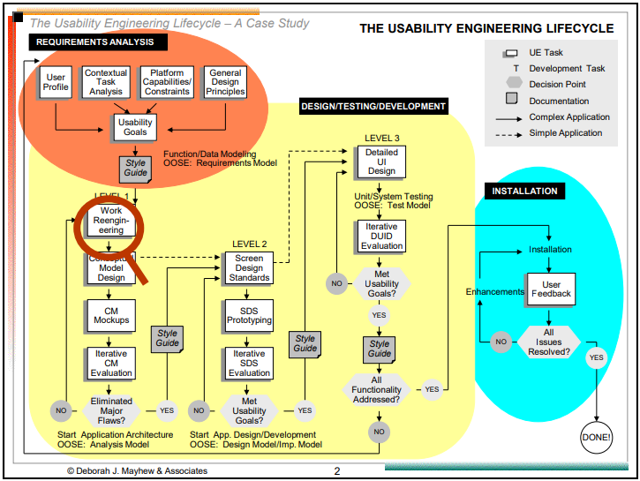
Notes:
The Usability Engineering Life Cycle
Bias and Mayhew (2005) created the Usability Engineering Life Cycle (UEL) as a means to build a usability test plan. If you can integrate the UEL into your product development cycle at the beginning, it will provide you with a rigorous analysis and testing regimen that will help you get the most out of your usability design, analysis, and testing.
The UEL is a cyclic model that incorporates three phases (Bias and Mayhew, 2005):
Requirements analysis—In this step, you establish your user characteristics, what tasks the product requires for operation so you can determine what the users need to do, set your goals for the usability study, and determine the usability study design guidelines.
Design, testing, and development—In this step, you create a structured, top-down approach to designing the product, be it a user interface, Web site, documentation, or a combination of the three. This is the step that requires the most feedback from your project team.
Installation—In this step, you gather feedback from users during and after the development process and share this feedback with the project team to determine if you need to make any product changes.
If you and your team find that any changes do need to be made, you will likely go back to Phase 2 and design, test, and develop the changes that your project team made. However, user testing could also expose flaws in the requirements analysis that would require you to reanalyze your requirements and then go through the steps again.
Mayhew and Tremaine (2005) assert that implementing the UEL to develop a usable Web site or Web-enabled application takes 8 to 12 months to develop and provide a decent ROI, but this assertion is an average estimate. My experience has shown that it doesn't take 8 to 12 months to design and publish a Web site, depending on how much programming is included in the site.
Therefore, for a Web site that doesn't incorporate a great deal of programming, more time may be needed to market the Web site and make incremental changes as needed. Web sites that require a lot of programming, such as dynamically driven Web sites that use databases to manage and output information, will take more time to develop. This could lengthen the amount of time to realize a decent ROI or keep the amount of time the same and require less time to realize ROI. The same is true of software development.
As the car commercials say, your mileage may vary. The UEL is only a guideline, and you can adapt the UEL to suit your needs, because every project is different. You may also be constrained by tight schedules that don't permit a thorough usability test. However, it's good to have a by-the-book description of how to engineer a usability test ready to go, and the UEL is flexible enough for you to select the tasks you need to perform a solid usability test. However, you should keep the 8 to 12 month timeframe in mind when you implement the UEL in your product development processes.
Phase 1: Requirements Analysis
You can gather your users' requirements for your product in a number of ways. For example, you can use paper prototyping to give people printed representations of what your product will look like and how the system will react to user input. You'll learn more about paper prototyping in Chapter 4. You can also observe the users and see how they work; you will learn more about user observations in Chapter 9.
No matter how you decide to obtain your requirements, you should ensure that you have covered the following points in your requirements analysis. Even if you did create a paper prototype or observe the user at work, be sure to review the following points to ensure that you have all the bases covered.
User profile—A description of your users' specific characteristics. There is no standard set of characteristics to measure, but you should pay particular attention to any issues that the user has with using the software, such as physical limitations.
Contextual text analysis—A study of your users' current tasks, workflow patterns, work environments, and conceptual frameworks. This context will help you understand why the user reacts the way she does to the software, hardware, or Web site being tested.
Usability goal setting—You need to set specific, qualitative goals that reflect the requirements you glean from the user profile. For example, you may want to have the users complete a task within a certain period and see if they can do that. If a user has some constraints that require a different method for completing the task, you should reset the goal for that user appropriately.
Platform capabilities and constraints—You must define the scope of possibilities for addressing usability needs by determining the capabilities and constraints of the interface or product. This information can also be affected by the usability needs of the users.
General design guidelines—You must apply generally accepted design guidelines for designing your interface. For example, there are guidelines for creating Web pages so that they appear correctly in every Web browser. You will learn more about design guidelines for user interfaces in Chapter 7, "Designing a User Interface," and for Web sites in Chapter 8, "Designing a Web Site."
Phase 2: Design, Testing, and Development
This phase is split into three levels of design work. Each level takes you from designing the concepts in the requirements analysis to developing a working product that users can test.
Level 1 Design
Level 1 design is the conceptual design level, which is where you design functionality, workflow, and rules. If you and your team have the time, you should get as much information from the users as possible before you decide how to design conceptual models. Models conceived from user input stand a far better chance of being accepted by users during the design evaluation stage in Level 3. The four steps in this level are as follows:
Work re-engineering—Your project team organizes functionality and workflow design based on the users' tasks and streamlines work before you begin design. No interface design is produced in this task.
Conceptual model design—The team creates high-level design rules for presenting information and interacting with the hardware, software, or Web site interface. If you have product screens or Web pages, this task doesn't go into that level of detail.
Conceptual model mockups—You can create paper prototype mockups, as you will learn about in Chapter 4. You can also create wireframe versions, which are small programs that show some functionality but not the entire program, or you can even create a prototype with nonoperating functionality such as small colored paper squares that represent lights on a hardware prototype.
Iterative conceptual model evaluation—The project team evaluates the mockups and modifies them through iterative evaluation processes. In other words, if the team decides it doesn't like one or more portions of the mockups, it works on those portions repeatedly until it decides that the portion looks good.
Level 2 Design
Level 2 design is where you create the standards for your project. Creating standards is especially important because everyone on the team needs to understand how the project will be put together. Having people creating their own standards as you develop the user interface design is a recipe for chaos. Four steps comprise this design level.
Design standards—Now that you have settled on a model, the project team must construct a set of interface- or site-specific standards and conventions that will apply to the design of the product.
Design standards prototyping—The project team applies the interface standards to product functionality. This functionality can be presented in specific screens or Web pages that you create to test the look and feel as well as links to other screens or Web pages.
Iterative design standards evaluation—The project team conducts formal usability testing or other types of evaluation to refine the screen design standards in the interface. This process continues until major usability issues have been resolved and usability goals are within reach. You'll learn more about usability testing in Chapter 9.
Style guide development—After you have a stable and validated set of screen design standards, you document this information along with the results of the requirements analysis in the product style guide and then distribute the documented information to all project team members. Other style guides, such as a general style guide for the company and the documentation style guide, could also affect the product style guide, and vice versa.
Level 3 Design
Level 3 design is the level at which you actually design the product after making all your preparations in the previous two levels.
Detailed user interface design—The project designers design the product based on the style guide conventions created in Level 2 design. The product that results is the "beta" version available for internal or external testers to use and test and for which they can provide feedback for the product team.
Iterative detailed user interface design evaluation—The project team conducts formal usability testing or other types of evaluation to refine the screen design standards in the interface. This process continues until the project team validates the product against usability goals.
Phase 3: Installation and Feedback
After the product has been installed and used for a period of time, the company should gather feedback from users about what they like and don't like about the product and how they use it.
You can obtain feedback in any number of ways: by e-mail, phone, mail, or on your Web site. You can send surveys to customers, and you may want to offer prizes or special offers to entice customers to return the surveys, especially if the surveys are long. You may also want to conduct focus groups either in person at your company building or at the client, or online using a collaborative software tool that employs real time videoconferencing such as WebEx, Microsoft LiveMeeting, or Raindance.
The Never-Ending Process
One thing to keep in mind is that the UEL really never ends. Feedback during the development process will ensure that you don't have many problems to fix after the product is out the door—and good feedback is always a feather in your company's cap. You will also need product feedback from your customers after the development process ends.
In addition, you may have upgrades to your product that need to be produced—or updates to the documentation you may want to place on the company Web site. So be sure to include the additional costs of implementing continual feedback as needed, especially between product releases, into your ROI proposal and your business case.

